Slide 1
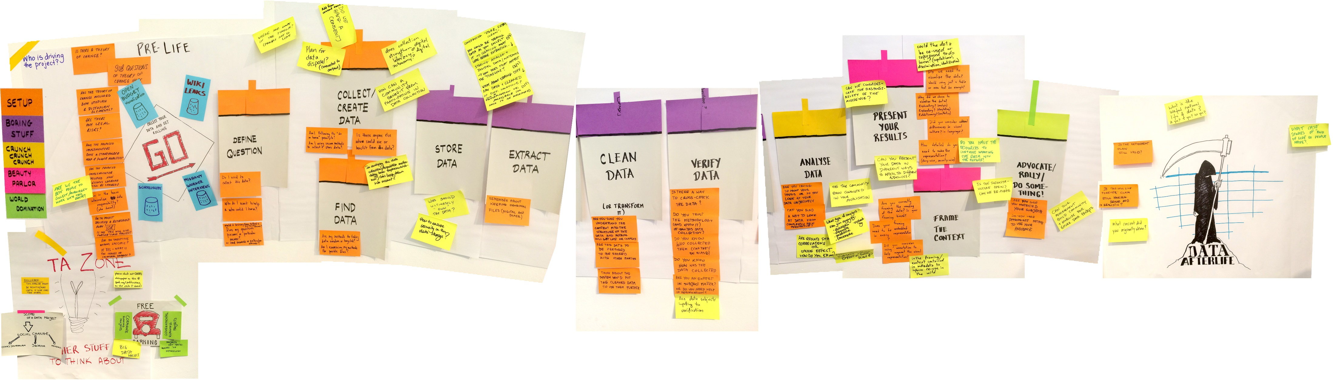

Data management planning for efficient research
The data lifecycle.
Result of the Responsible Data Forum Resource Sprint, Oct 2014, Budapest. Wikipedia, CC-BY-SA
Laura Standaert, data steward Life Sciences Ghent University
Attribute to: Ghent University Data Stewards

Slide 2
Without planning…
teams/labs often lose data when researchers leave
working with data from collaborators can be problematic
there often is no budget allocated to maintaining data(bases) beyond a project’s end
gaining consent for archiving and sharing data is often forgotten
…
DMPs take some time & effort upfront, but can save you headaches later on!
Notes:
Losing data sometimes not being able to find back data (even though it is available)

Slide 3
Data Management Plan (DMP)
Outlines how research data will be handled during & after a project.
Increasingly required by research funders/institutions - as a first step towards good research data management (RDM)
Data collection
Data processing & analysis
Publication & data sharing
Data preservation
Data reuse
Documentation & metadata
Storage & back-up

Slide 4








Main dmp sections
Data summary / description
Purpose, origin, type, format & volume of the data
Ethical and legal issues
IRB approval, IP, GDPR
Data sharing and reuse
Repositories, terms, contracts, licenses
Documentation and metadata
Where and how, standards, ontologies, vocabularies
Data storage during the project
Security, back-up, transfer & access
Resources
Costs
Long-term preservation
What, where, restrictions?
Responsibilities
Owner and roles

Slide 5
Dmp: first version vs. last version
First scope of reusability.
Basic information about your data.
Data storage and back up vs. long term preservation.
Initial idea about metadata standards and dedicated archive / repository.
Identification of legal and/or ethical issues.
Establishing responsibilities.
Data Management Plan
First submission
Data Management Plan
Final submission
Definite selection of reusable outputs.
Precise description of all data types.
Clear long-term preservation strategy: selected data archive(s) and/or repository(ies).
FAIR data and open data (“As open as possible, as closed as necessary”).
Adapted from: Jasmin Böhmer. (2019, September). UBC RDM Workshop 1 - Data Management Planning (Version V2). Zenodo. http://doi.org/10.5281/zenodo.3469953

Slide 6
DMP software dmponline.be

Slide 7
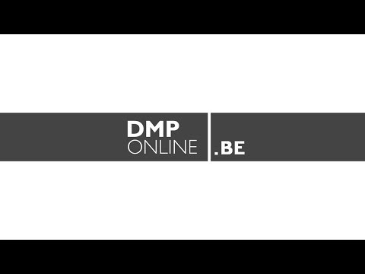
DMPonline.be tutorial
https://onderzoektips.ugent.be/en/tips/00001281/
https://www.youtube.com/watch?v=5U9_DDdBzYk

Slide 8
What to cover in your DMP

Slide 9
Main dmp sections
Data summary / description
Purpose, origin, type, format & volume of the data
Ethical and legal issues
IRB approval, IP, GDPR
Data sharing and reuse
Repositories, terms, contracts, licenses
Documentation and metadata
Where and how, standards, ontologies, vocabularies
Data storage during the project
Security, back-up, transfer & access
Resources
Costs
Long-term preservation
What, where, restrictions?
Responsibilities
Owner and roles

Slide 10
Research Data summary
List and describe all datasets or research materials that you plan to generate/collect or reuse during your research project.
If you reuse existing data, please specify the source, preferably by using a persistent identifier (e.g. DOI, Handle, URL etc.) per dataset or data type

Slide 11







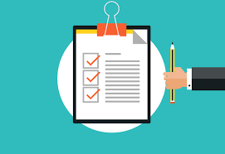
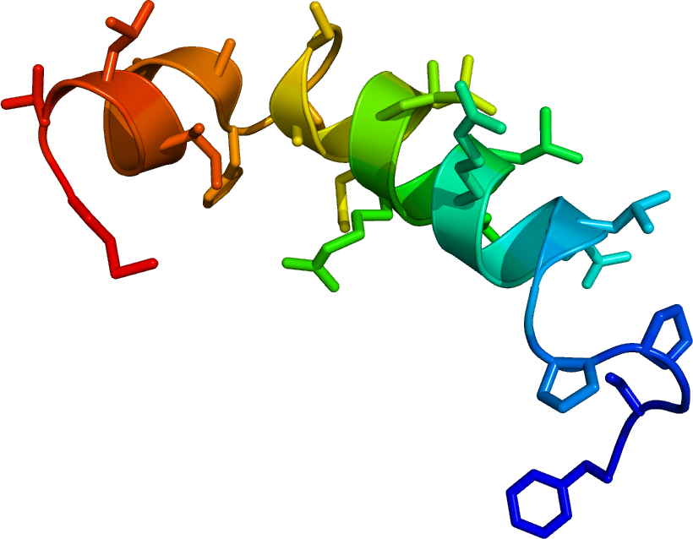
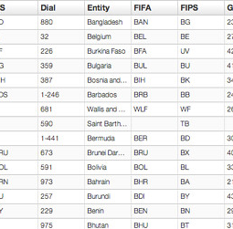
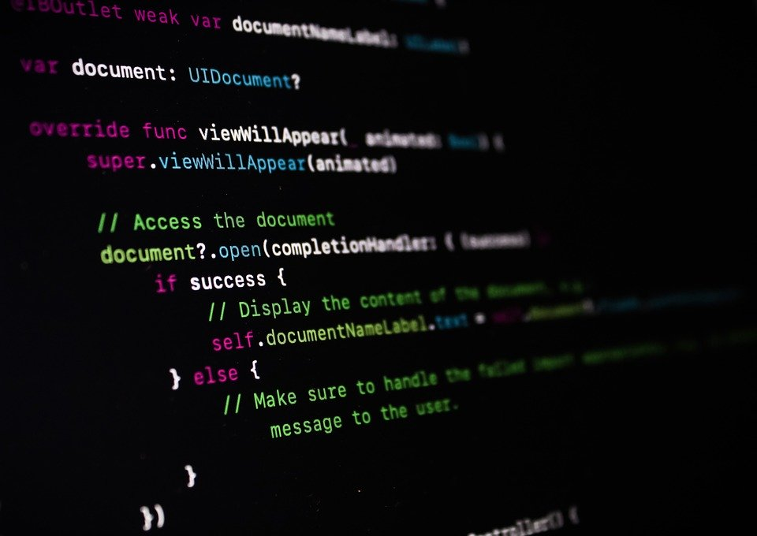
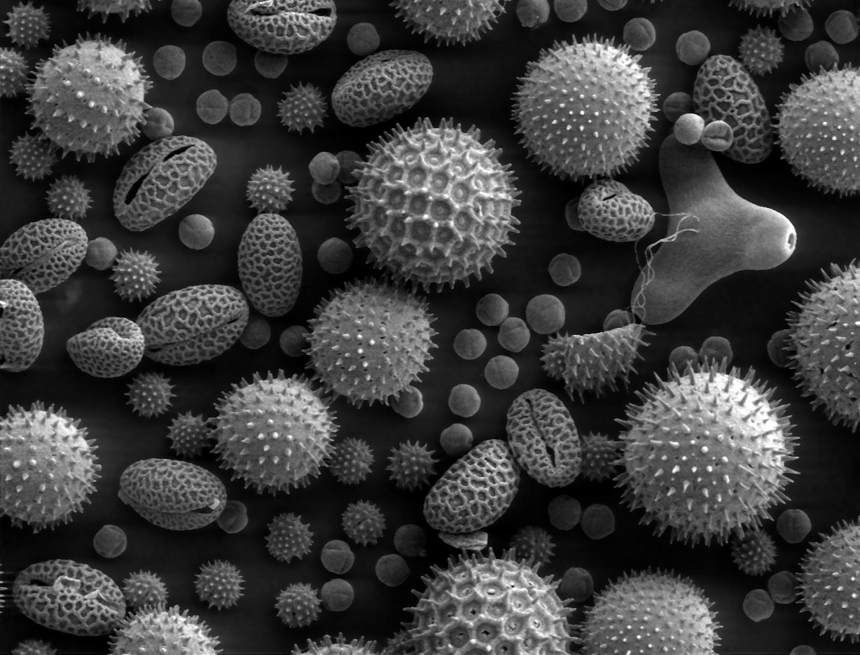
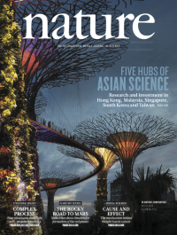
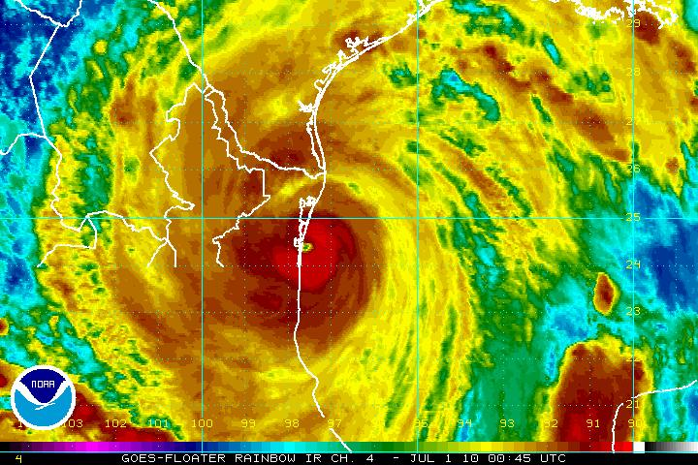
research data can mean a lot
Survey
Measurement
Observation
Code
Image
Document
Visualisation
Research data is any information that has been collected, observed, generated or created to validate original research findings.

Slide 12
Data description – SOME Tips
Only provide answers relating to research data, not publications!
Remember that ‘research data’ come in many different forms
Clear distinction between re-used and new data.
Break down and list your data types conveniently: e.g. by technique, by purpose, by research phase.
Provide enough details for outsiders to understand the sort of data involved
e.g. distinguish between digital/non-digital data, quantitative/qualitative data, raw & processed data
specify file formats (preferably no proprietary/unusual formats)
specify data collection methods (e.g. experimental, observational, simulation… data)

Slide 13
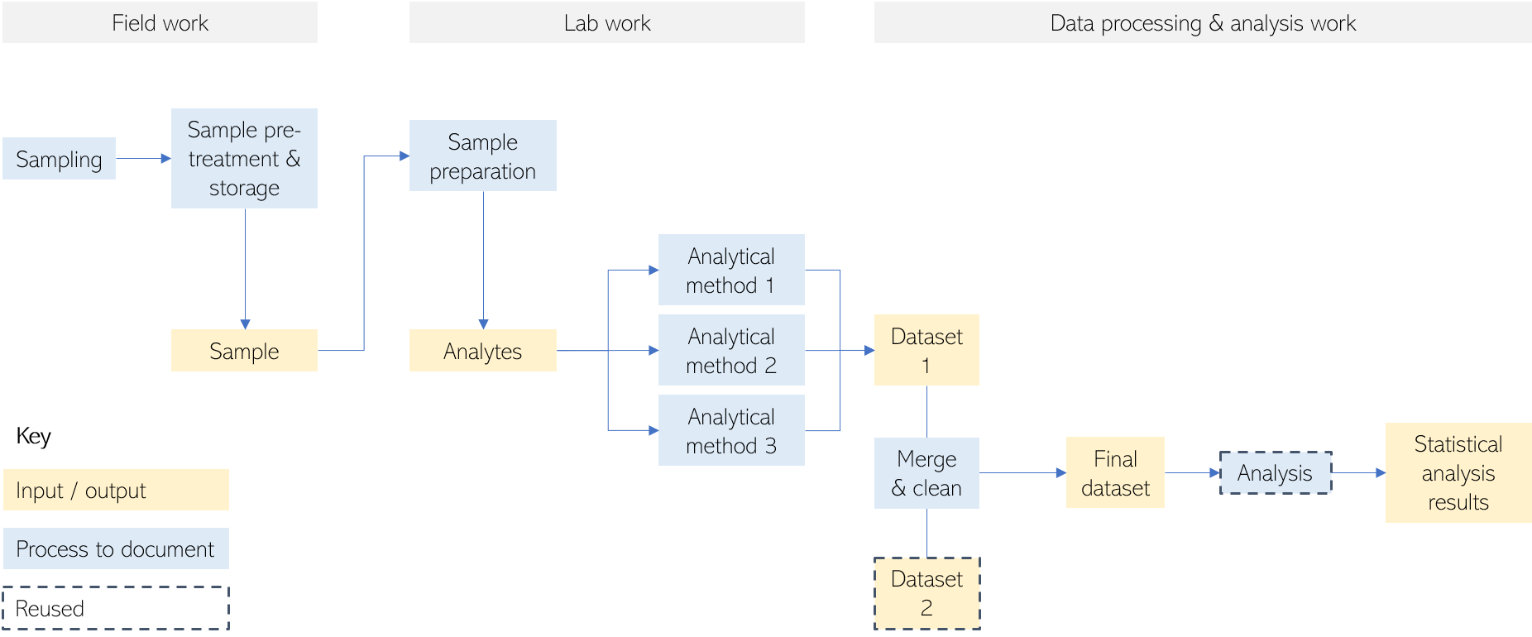
Data Description: preparation
Complex project structure, identify datatypes
Design a data flow
Example

Slide 14
Data Description: data table approach
Dataset | Description | Data type | Format | Expected Volume
Farmer-survey | Questionnaire for farmers in Flanders | Observational qualitative | Paper and pencil + digitized transcript (.docx) | <1 GB, paper surveys of 300 participants
 |  |  | Smartphone based questionnaire. Exported tables as .csv | <1 GB
Tracker data | Activity tracker for data subjects | Observational quantitative | Physical activity and sedentary time in .GT3X files | 250 KB per subject x 300 subjects = 75 MB
Farmer-interview | Interview with a selection of farmers | Observational qualitative | .MP3 + transcript in .docx | About 5 GB
mRT-activity | Micro-randomized trial to determine the effect of isolated determinants on physical activity | Experimental | Digital textual and numerical data combined in spreadsheets and obtained via tracker based experiment. CSV format and GT3X for raw activity tracker data | <5 MB for the CSV files. Raw accelerometer data (.GT3X files) are 250kB per subject x 40 subjects per experimental study = 10MB
mRT-sendentary | Micro-randomized trial to determine the effect of isolated determinants on sedentary time | Experimental | Digital textual and numerical data combined in spreadsheets and obtained via a tracker based experiment. CSV format and GT3X for raw activity tracker data | <5 MB for the CSV files. Raw accelerometer data (.GT3X files) are 250kB per subject x 40 subjects per experimental study = 10MB
Example

Slide 15
Data Description: data table approach
Dataset name | Description | New or reused | Data type | Data format | Volume
WP1 Pollutant concentration before and after treatment | Comparison of the concentration of heavy metals and organic pollutants before and after different thermochemical treatment | New | Experimental, quantitative | xlsx, csv | <5MB
WP1 Nutrient bio-availability | Comparison of nutrient bio-availability after different thermochemical treatments | New | Experimental, quantitative | xlsx, csv | <5MB
WP1 Data from statistical analysis | Results from statistical analysis to determine the influence of the dependent variables (chemical treatment/reactors, temperature, retention time) in pollutant removal and nutrient bio-availability. | New | Analysis script & results, quantitative | R, csv, png | <20MB
WP2 Consumers attitudes - questionnaire responses | Data on attitudes towards consumption of food that has been grown using fertilisers based on recycled human excreta. Online questionnaires will be performed using Qualtrics and will collect: demographic data from participants: place of residence, age, gender, education, occupation, annual income. respondent's opinions or views about issues in relation to the research topic: environmental awareness questions, attitudes or acceptance of the proposed product, etc. | New | Observational, quantitative & qualitative | csv | <5MB
WP2 Consumer attitudes - analysis | Statistical analysis of survey responses | New | Analysis results, quantitative | sav | <10MB
Example

Slide 16
Data table(1)
Bonus: Detect RDM needs
There is not a "one size fits all" approach
How much granularity is needed and how do I break down the data into different rows?
It depends on your project and a good approach is to categorize the content in a way that proves useful for the management of your data
E.g. Divide your data according to:
content type (quantitative vs. qualitative)
data collection method (observational, experimental, simulation)
by purpose
by format
differentiate between own data and third-party data

Slide 17
Data table(2)
Bonus: Detect RDM needs
How many columns or characteristics should I provide?
DMP templates will explicitly require some characteristics, e.g. description, new or reused, data type, format and expected volume
If possible, add other relevant characteristics that are specific to your data and that have implications for data management. E.g.:
temporal and geographical scope of the data
data is sensitive or not
access restrictions

Slide 18


Ethical & legal issues
Questions (1)
Will you process personal data? If so, briefly describe the kind of personal data you will use in the comment section. Please refer to specific datasets or data types when appropriate.
Are there any ethical issues concerning the creation and/or use of the data (e.g. experiments on humans or animals, dual use)? Describe these issues in the comment section. Please refer to specific datasets or data types when appropriate.

Slide 19



Ethical & legal issues
Questions (2)
Does your work have potential for commercial valorization (e.g. tech transfer, for example spin-offs, commercial exploitation, …)? If so, please comment per dataset or data type where appropriate.
Do existing 3rd party agreements restrict dissemination or exploitation of the data you (re)use? If so, to what data do they relate and what restrictions are in place?
Are there any other legal issues, such as intellectual property rights and ownership, to be managed related to the data you (re)use?

Slide 20

Data documentation & metadata
Questions
Clearly describe what approach will be followed to capture the accompanying information necessary to keep data understandable and usable, for yourself and others, now and in the future.
Will a metadata standard be used to make it easier to find and reuse the data? If so, please specify (where appropriate per dataset or data type) which metadata standard will be used. If not, please specify (where appropriate per dataset or data type) which metadata will be created to make the data easier to find and reuse.

Slide 21








WHAT
WHO
WHY
WHERE
WHEN
HOW
Review & verification of research
Reproducibility
Make data understandable and reusable

Slide 22
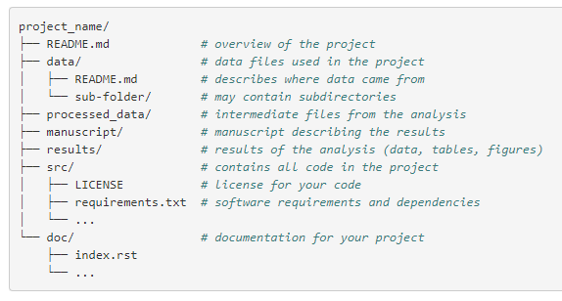
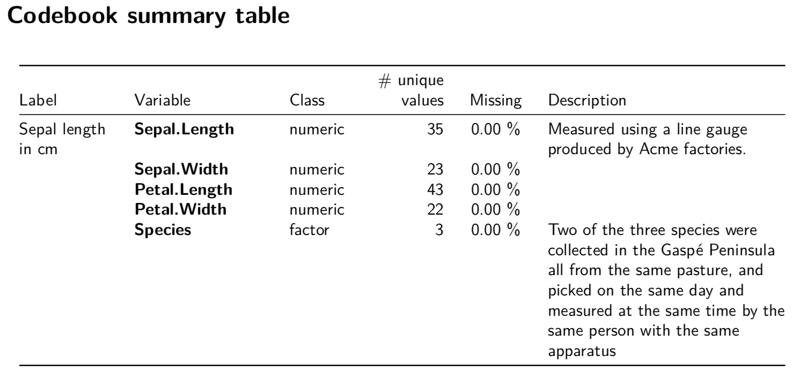
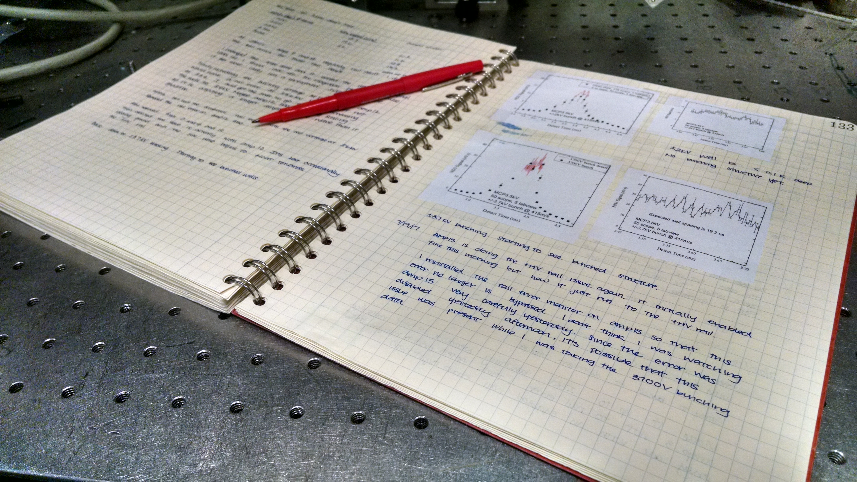
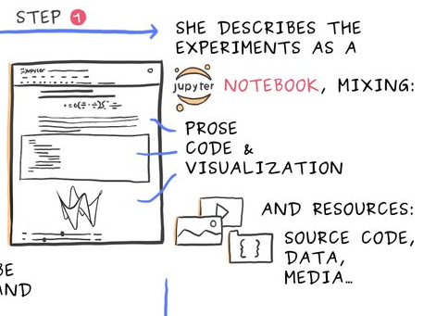
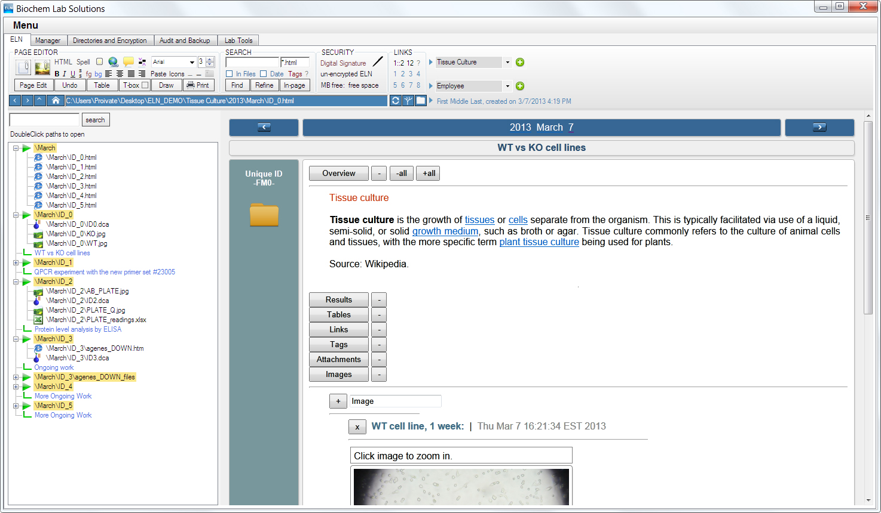
Readme files
Codebooks
Paper and electronic lab notebooks
Jupyter notebooks
https://opendreamkit.org/2017/11/02/use-case-publishing-reproducible-notebooks/

Slide 23
Data storage & backup
Questions
Where will data be stored?
How will the data be backed up?
Is there sufficient storage & backup capacity during the project? If yes, specify concisely. If no or insufficient storage or backup capacities are available, then explain how this will be taken care of.
What are the expected costs for data storage & backup during the project? How will these costs be covered?
Data security: how will you ensure that the data are securely stored and not accessed or modified by unauthorised persons?

Slide 24
Data Sharing & reuse
Questions (1)
Will the data (or part of the data) be made available for reuse after/during the project? In the comment section please explain per dataset or data type which data will be made available.
If access is restricted, please specify who will be able to access the data and under what conditions.
Are there any factors that restrict or prevent the sharing of (some of) the data (e.g. as defined in an agreement with a 3rd party, legal restrictions)? Please explain in the comment section per dataset or data type where appropriate.

Slide 25
Data Sharing & reuse
Questions (2)
Where will the data be made available? If already known, please provide a repository per dataset or data type.
When will the data be made available?
Which data usage licenses are you going to provide? If none, please explain why.
Do you intend to add a PID/DOI/accession number to your dataset(s)? If already available, you have the option to provide it in the comment section.
What are the expected costs for data sharing? How will these costs be covered?

Slide 26
Data PRESERVATION
Questions
Which data will be retained for the expected 5-year period after the end of the project? In case some data cannot be preserved, clearly state the reasons for this.
Other terms apply to Clinical trials, patient records, ‘experiments’, …
Where will these data be archived (= stored and curated for the long term)?
What are the expected costs for data preservation during the expected retention period? How will the costs be covered?

Slide 27
Responsibilities
Questions
Who will manage data documentation and metadata during the research project?
Who will manage data storage and backup during the research project?
Who will manage data preservation and sharing?
Who will update and implement this DMP?

Slide 28
DMP tips
Be consistent throughout the document.
If a dataset cannot be shared, do not mention in a later paragraph that all data will be shared openly on Zenodo
If certain information is not available yet, mention when and how you will address the issue
Be complete for every question: mention all datatypes or outputs.
E.g.: For WP1 this question is not applicable, for WP 2-3 we will do this, and for WP 4-6 we will do that.

Slide 29



Ghent University Data Stewards research Department - University Library rdm.support@ugent.be @UGentRDM ugent.be/en/research/datamanagement
Please reuse content of this presentation, and attribute to: Ghent University Data Stewards, CC BY 4.0

